Slide 1
Why Get Certified?
Learn Azure
Shows proof of your knowledge

Slide 2
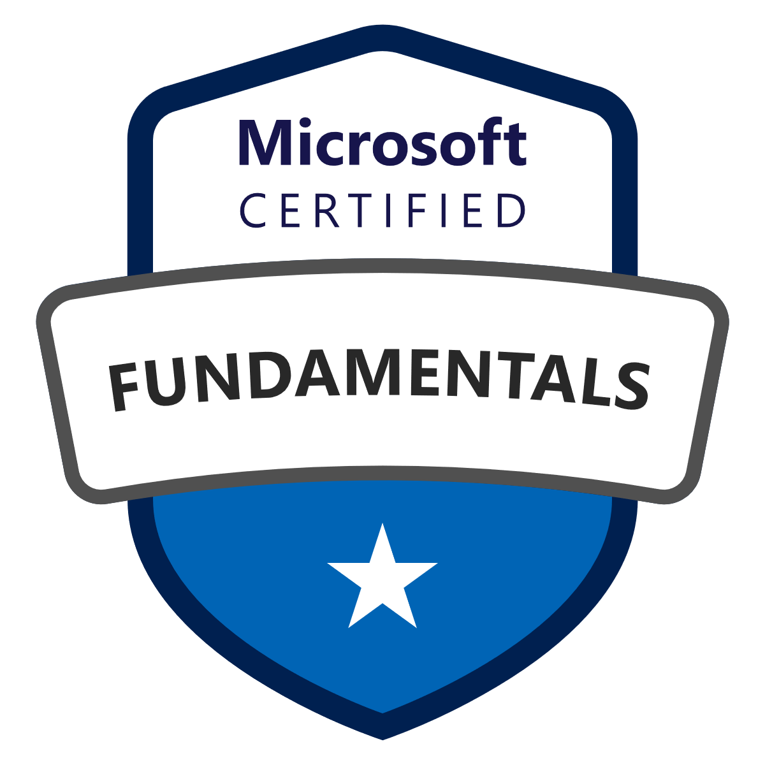



Azure Certifications for Developers
Azure Fundamentals
Azure Developer Associate
Azure Solutions Architect Expert
AZ-900
AZ-204
AZ-303 (Azure Architect Technologies)
$165 USD
$99 USD
$165 USD
AZ-304 (Azure Architect Design)
$165 USD
Azure IoT Developer Specialty
Offer: Microsoft Exam Replay
(1 exam + 1 retake)
$215 USD
AZ-220
$165 USD

Slide 3
How Can I Get Started?
1. Pick an exam
2. Study for the exam
3. Register for the exam
(Pearson VUE)
4. Take the exam
2a. Download the “skills outline”
Multiple choice
Drag & Drop
Case Studies
2b. Learn online
Microsoft Learn
Pluralsight
2b. Learn from an instructor
2c. Test your knowledge
Practice exams

